Slide 1
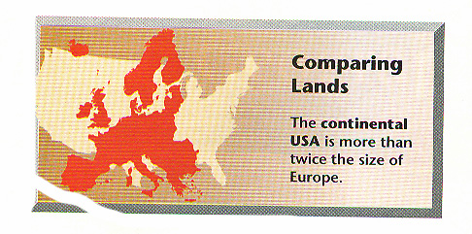

Slide 2
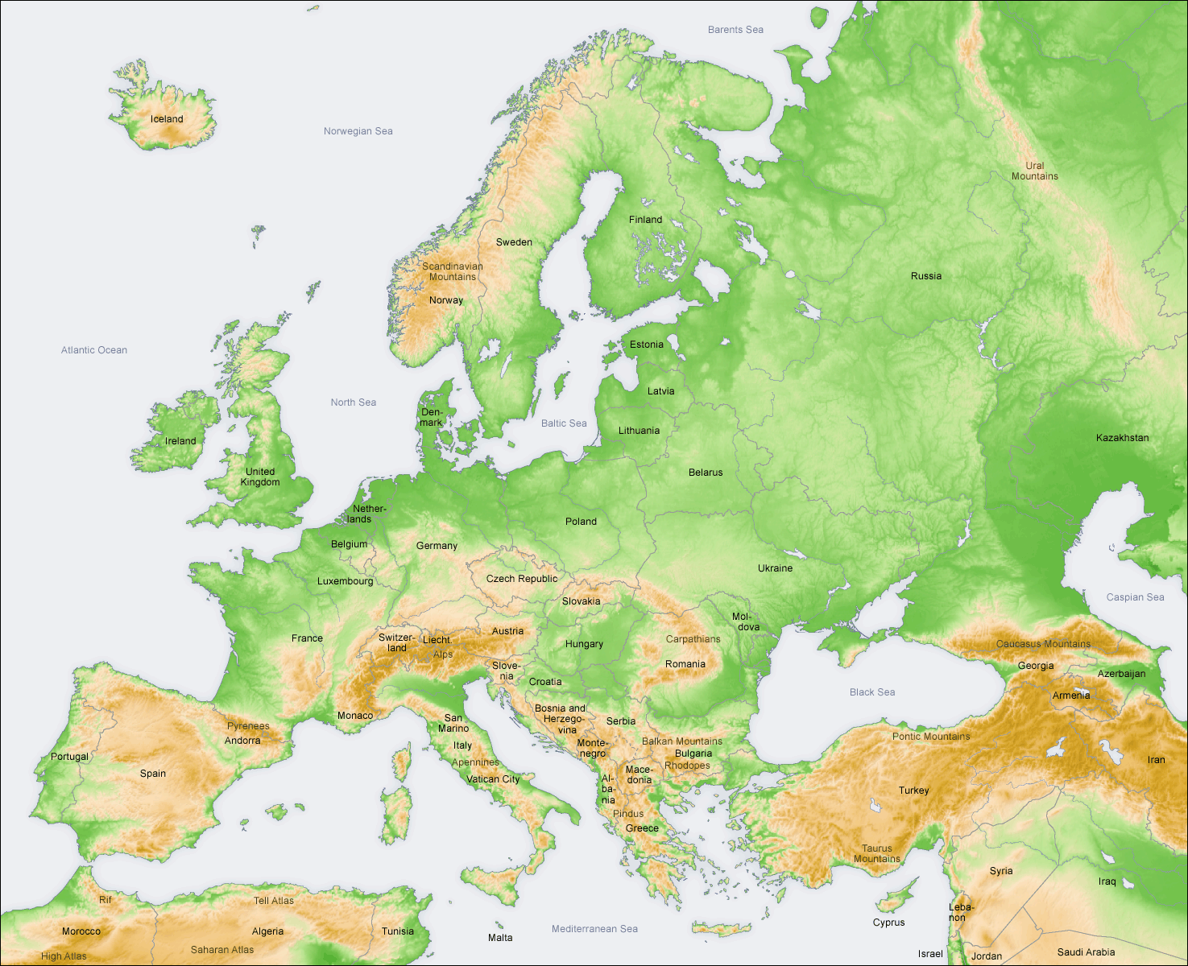

Slide 3
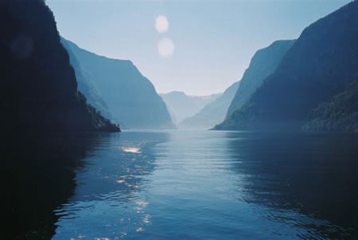
Fjord Long steep-sided glacial valley now filled by seawater

Slide 5
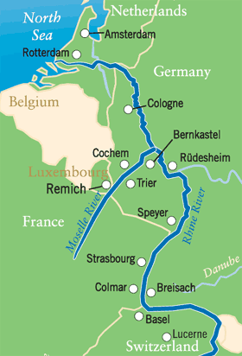
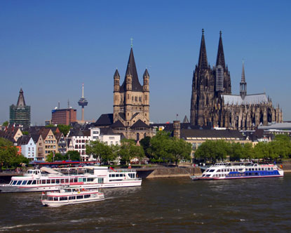
Rhine River

Slide 6
Strait
A narrow passage of water connecting two large bodies of water
Bosporus
Gibraltar
Dardanelles

Slide 7
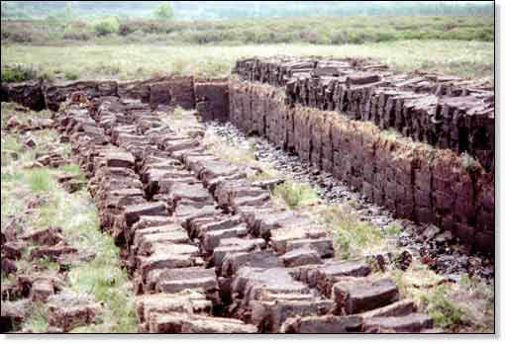
Peat A highly organic material found in marshy or damp regions, composed of partially decayed vegetable matter: it is cut and dried for use as fuel

Slide 8
