Slide 1
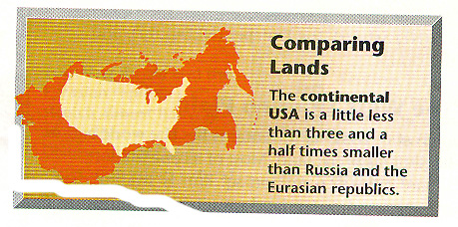

Slide 2
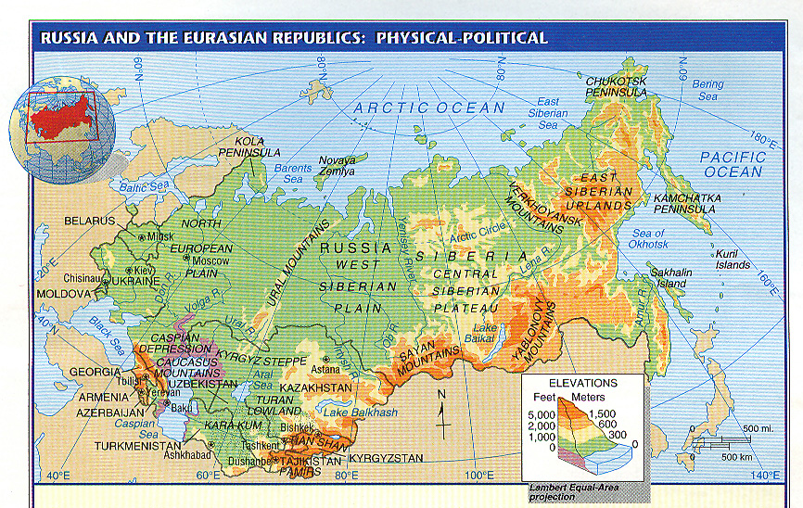

Slide 3
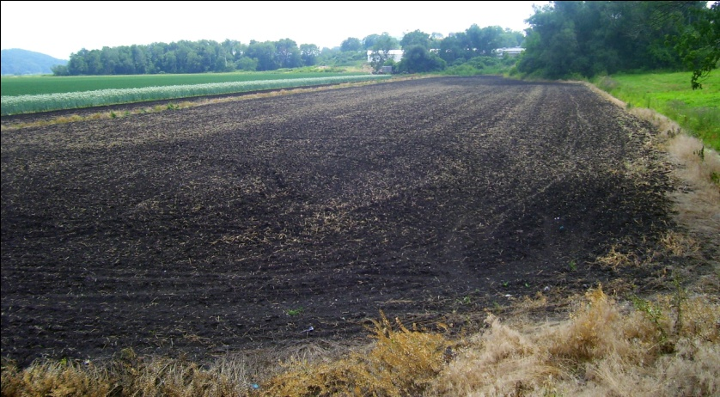
Black Earth Belt
Rich soil (chernozem) allows region to produce huge amounts of grains; “Breadbasket”

Slide 4
