Slide 1
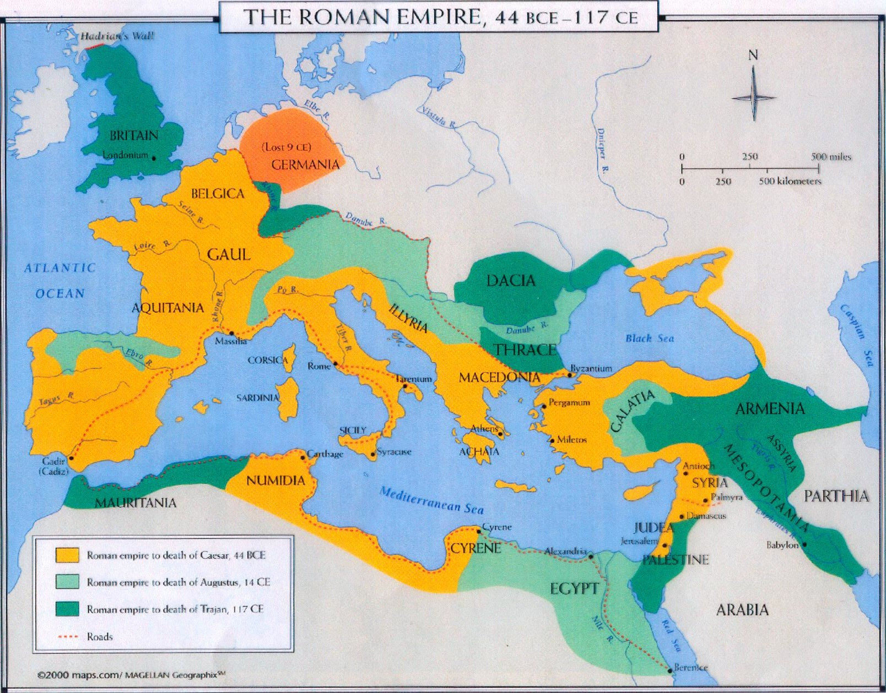

Slide 2
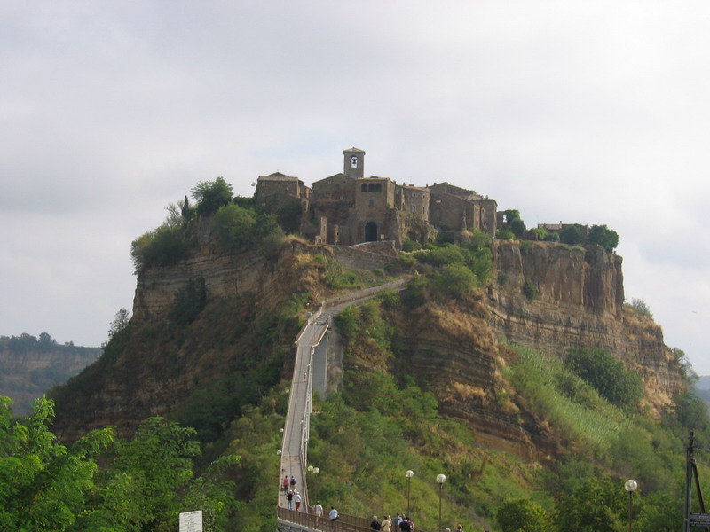
Etruscans
Civita di Bagnoregio
This was once the main Etruscan road leading to the Tiber Valley and Rome

Slide 3
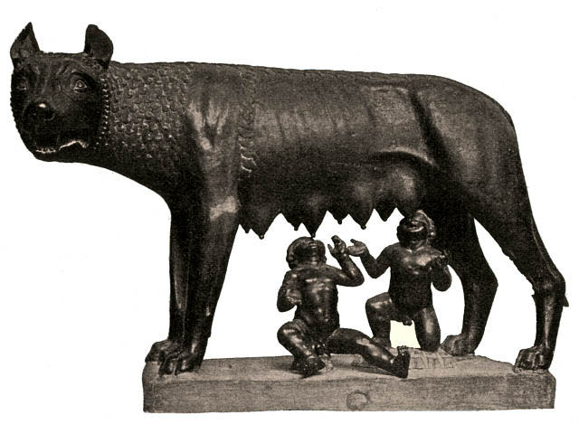
Bronze statue honors the wolf that rescued and cared for Romulus and Remus in the legend of Rome’s founding.

Slide 4
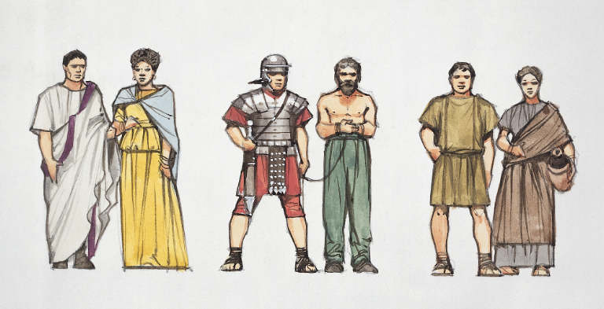
Roman Society

Slide 5
Senate

Slide 6
Laws of the Twelve Tables

Slide 8
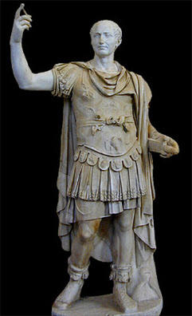
Julius Caesar

Slide 9
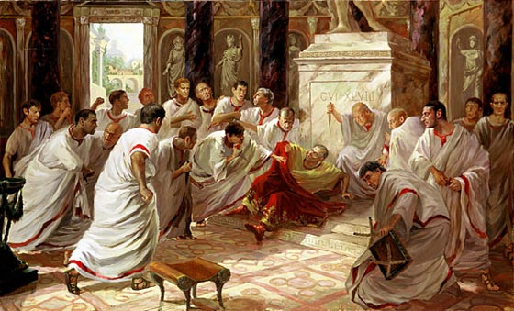
Violence in the Senate

Slide 10
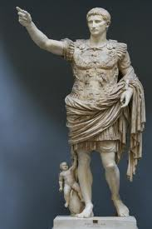
Caesar’s Adopted Son – Octavian (Augustus)

Slide 11
Roman Society

Slide 12
Patrician Home

Slide 14
Clothing

Slide 16
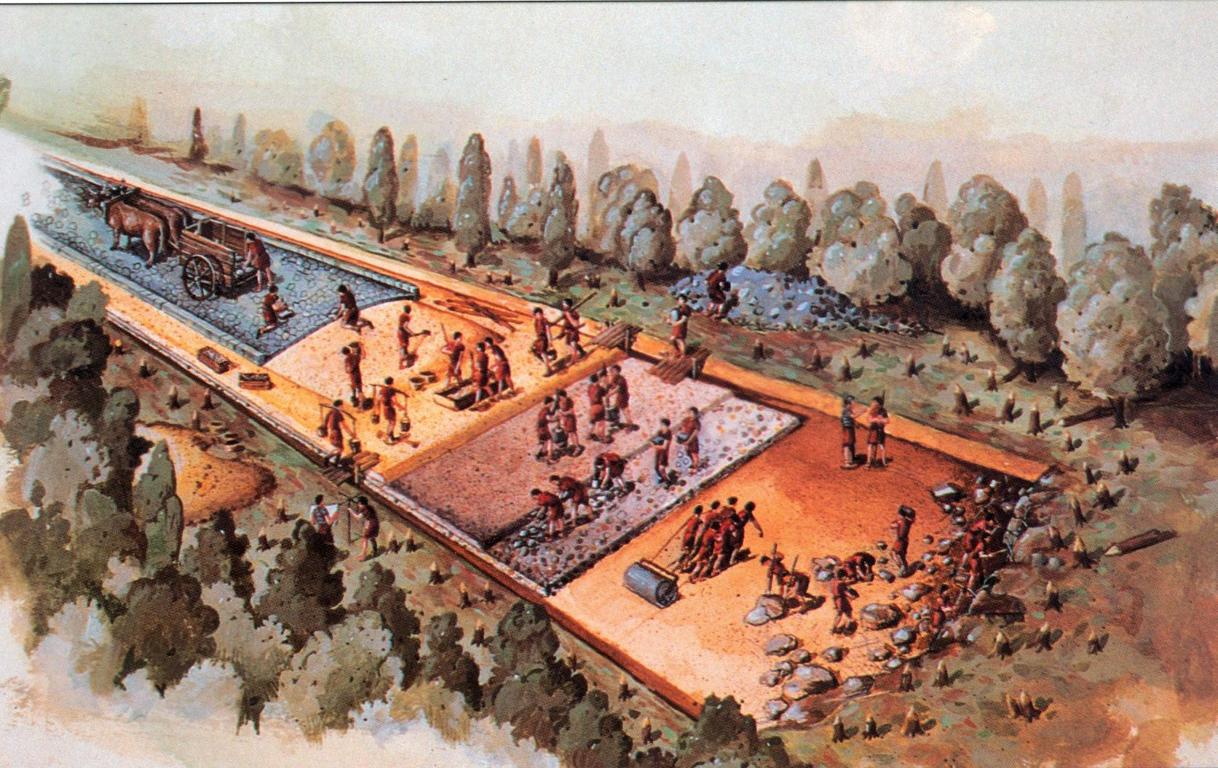
All Roads Lead to Rome 53,000 Miles

Slide 18
Bridges Use of the Arch

Slide 19
Aquaduct Artificial channel for carrying water

Slide 20
Roman Baths Large public areas to bathe, exercise, and relax

Slide 21
Pantheon Temple dedicated to all major gods; first free-standing dome

Slide 22
Looking up you will see the engineering marvel of its massive concrete dome. The Pantheon still holds the record for the largest unreinforced concrete dome in the history of architecture. The interior of the roof was possibly intended to symbolize the arched vault of the heavens. The Great Eye at the dome's apex is the source of all light, except for what comes in through the front doors.

Slide 23
Roman Forum Public square and market place

Slide 24
Colosseum Amphitheater where gladiatorial games were held

Slide 25
The Games
Gladiator: Professional fighter (most were slaves)
Ludus: A training school for gladiators
Lanista: Person who trained gladiators.

Slide 26
The Games
http://www.youtube.com/watch?v=iaYffgD6nBA

Slide 27
Circus Maximus Large stadium where chariot races were held

Slide 28
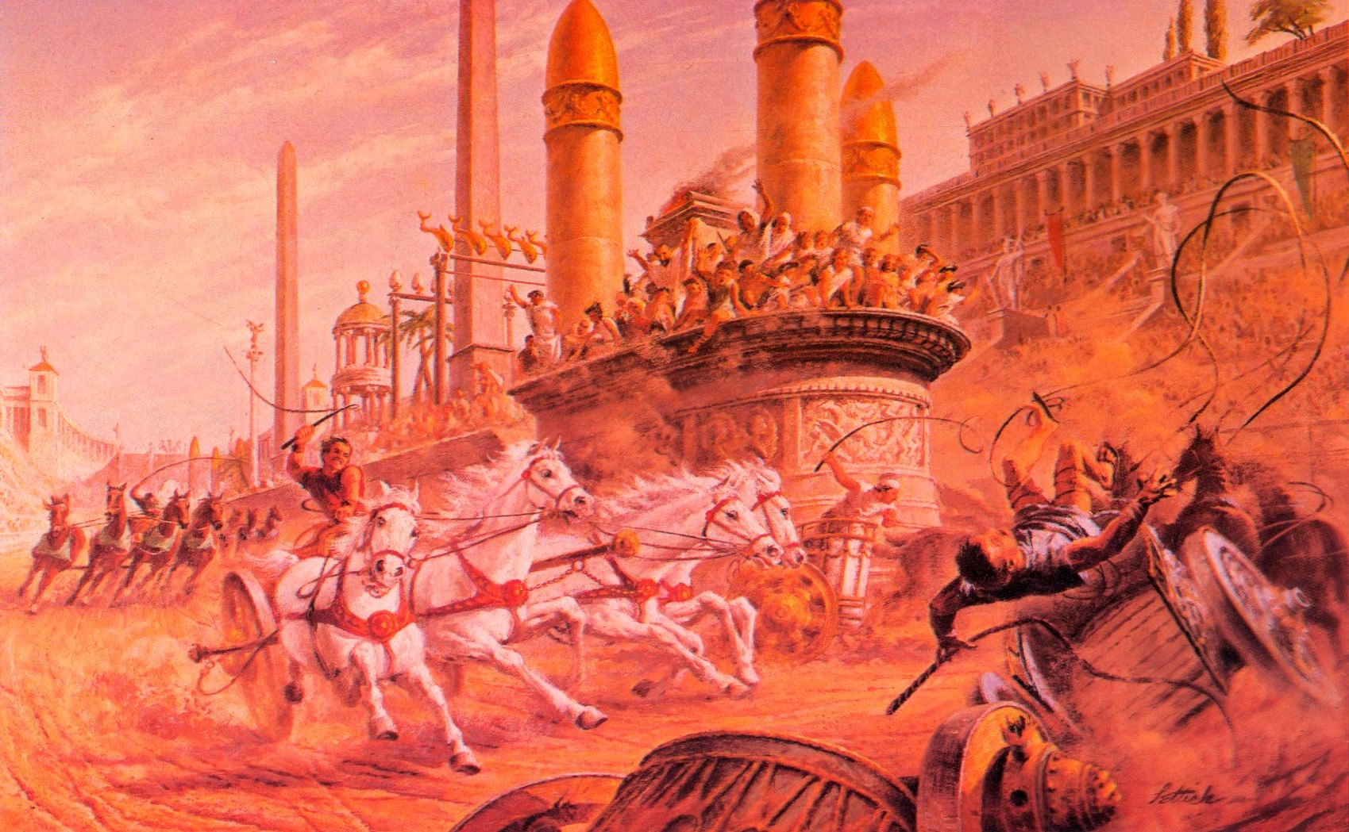
Chariot Races

Slide 29
Ben Hur
http://www.youtube.com/watch?v=v31sXoATz5Y

