Slide 1
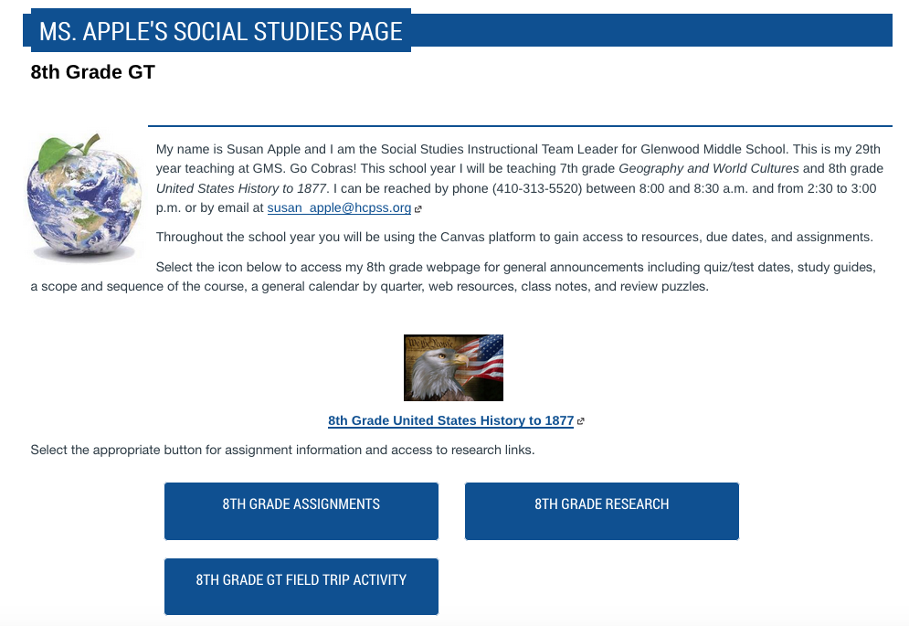



HCPSS Connect
https://www.hcpss.me/
GMS’ Phone Number
410-313-5520
Planning Period: 8:00 to 8:30
Email
susan_apple@hcpss.org
I check email at 2:30 pm
Students may see me for additional help during homeroom and Wednesday’s Advisory Period

Slide 3
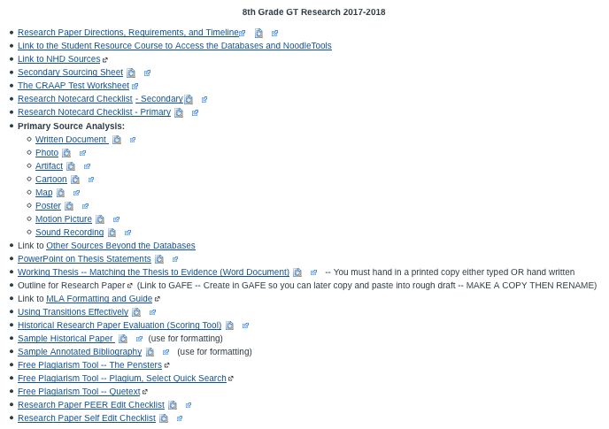

Slide 4

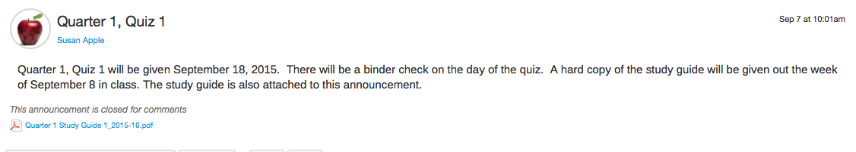
Announcements made through the Canvas learning management system (HCPSS Connect) and directly through my web page (www.gmshistory.net)

Slide 5


Slide 6


Slide 7
